Slide 1
Comparing Classification Models
Group 10 Tommy Tran Rohit Taneja Chris S

Slide 2
Dataset Summary
Dataset consists of 1,473 instances surveyed from married women with 10 attributes (including the class attribute)
Attributes:
Wife’s Age
Wife’s Education
Husband’s Education
Number of Children
Wife’s Religion (Islam or Non-Islam)
Wife’s Employment Status
Husband’s Occupation
Standard-of-Living Index
Media Exposure
Contraceptive Method Used (Class Attribute: No Use, Short Term or Long Term)
Class Distribution:
No Use – 629 (42.70%)
Short Term – 511 (34.69%)
Long Term – 333 (22.61%)

Slide 3
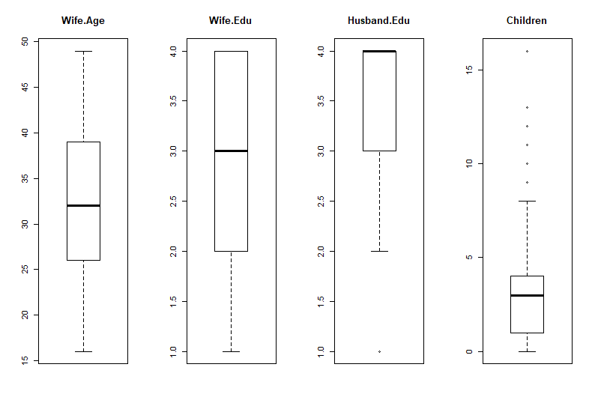
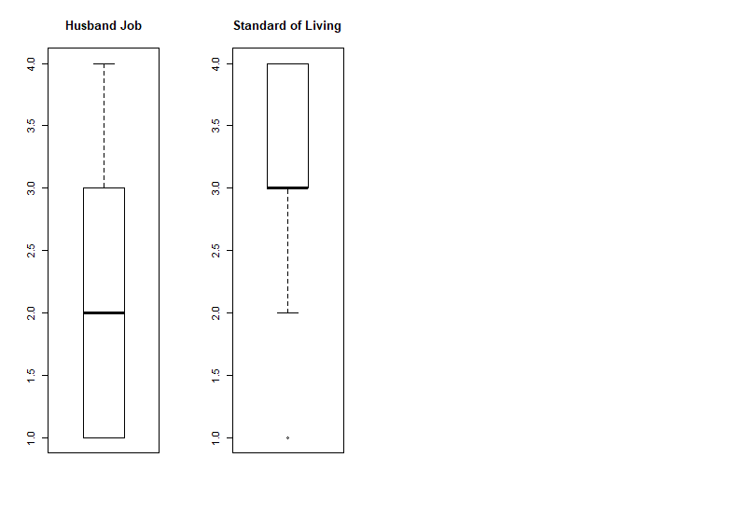
Dataset Visualization

Slide 4
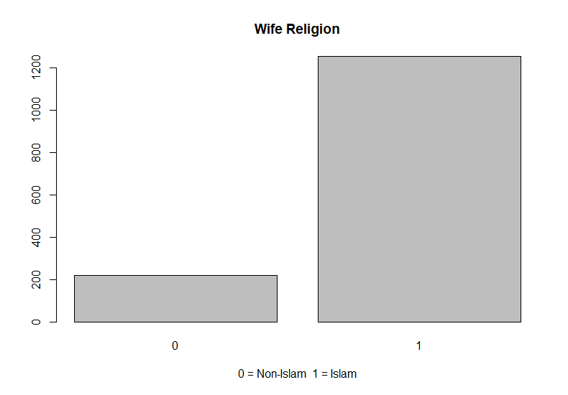
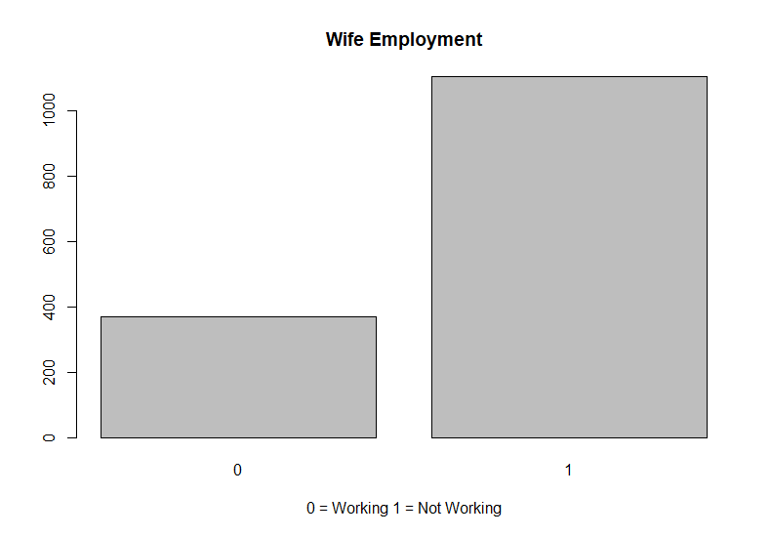
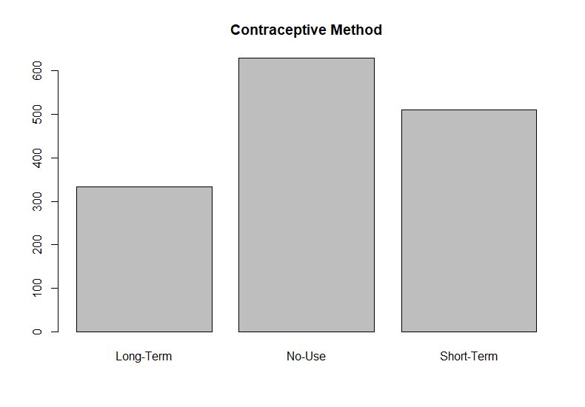
Dataset Visualization

Slide 5
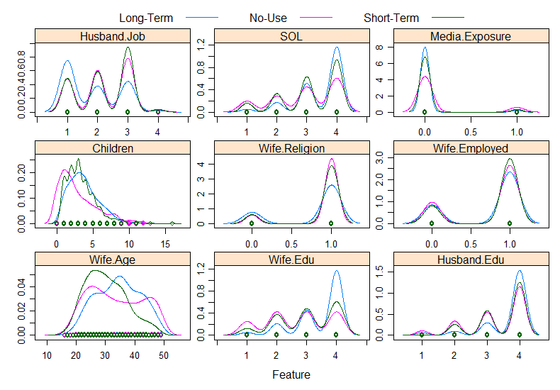
Dataset Visualization

Slide 6
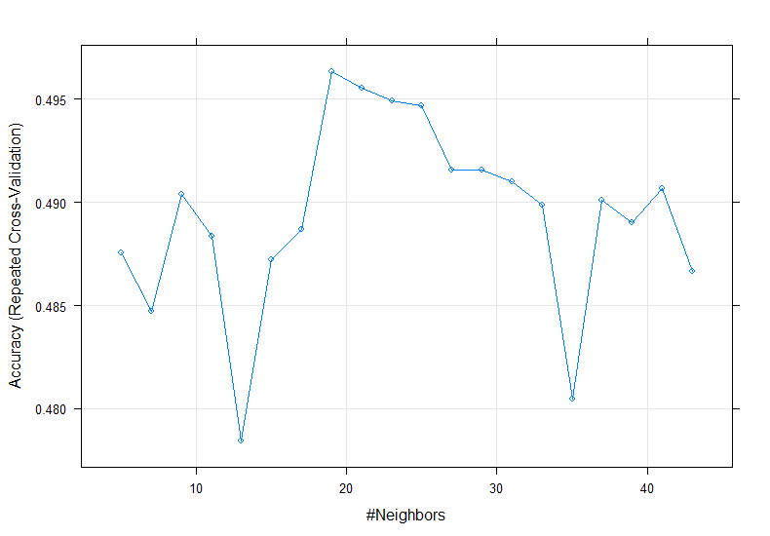
kNN Classification Model
Normalized the data before building the model.
Accuracy measured using 10-fold cross validation.
Dataset divided by 80% to the training set and 20% to the testing set.
When using the training set (1176 instances) to build the kNN model, accuracy was highest of 49.6% when k = 19.

Slide 7
kNN Model Performance
When measuring the performance of the model by attempting to predict the testing set (297 instances), it had an accuracy of 52.19%
Breakdown of prediction results:
“No Use” accuracy – 67/115 (58.26%)
“Short Term” accuracy – 59/122 (48.36%)
“Long Term” accuracy – 29/60 (48.33%)
Variable importance analytics (top 5 in order):
“No Use” – Wife’s Education, Standard of Living, Number of Children, Husband’s Job, Husband’s Education
“Short Term” – Wife’s Age, Husband’s Job, Wife’s Education, Standard of Living, Number of Children
“Long Term” – Wife’s Education, Wife’s Age, Standard of Living, Husband’s Job, Number of Children

Slide 8
SVM Classification
Used Python (Scikit-learn) to Classify the dataset and Find results.
Steps taken to get to the result
Preprocessing - Normalized the data
Train the data
Used Various kernel function to get the best accuracy
Rbf = 57%
Gamma = 57%
Sigmoid = 44%
Next Steps
Remove binary attributes/Change them so see if it improves accuracy

Slide 9
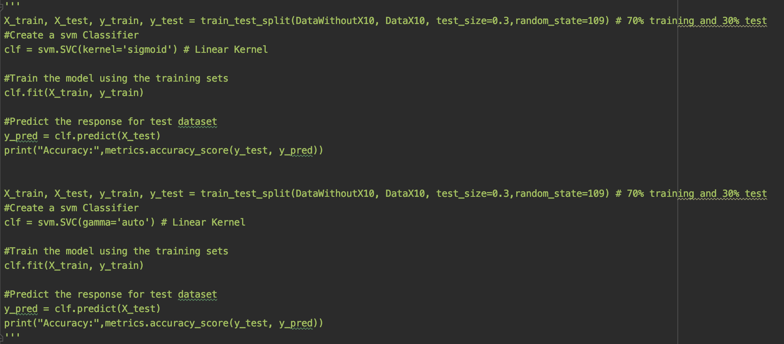
SVM Classification

Slide 10
Neural Network Model
Normalized the data to [0,1] (including the classification variable using min/max)
Using the neuralnet-package
Hidden Layers: 3
Nodes: 9,5,2
Setup required a threshold of 0.9 to converge
10-Fold CV yielded 46.8%

Slide 11
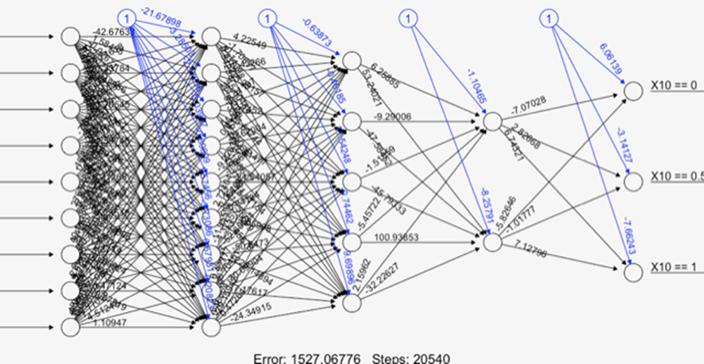

Neural Network Model

Slide 12
Comparing the Models
Overall, all 3 of the models performed similarly. Neural Network and SVM slightly performed better than kNN.
Neural Network was significantly harder to debug for higher accuracy while SVM and kNN were easy.

Slide 13
Conclusion
The dataset needed a lot more tweaking in order to bring the accuracy up to a functional level.
The dataset’s attributes did not have a lot of distinction between the three class variables therefore it was harder to build models with high accuracies.
For this dataset, either the SVM or Neural Network model would be preferred out of the 3 classification models.

